Slide 1
Grasping gestures
Finger gestures performed while
hand holding objects
05/19/2015

Slide 2
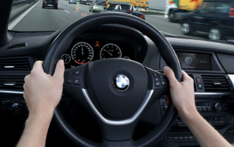
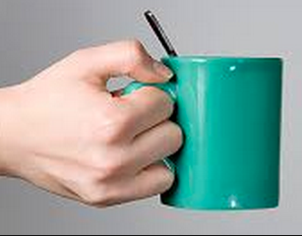
Motivation/Intro
Promise
Users are able to perform gestures while holding objects, e.g. driving cars, holding a cup…
Obstacle
But vision based tracking has many limitations, e.g out-of-view, occlusion, complex algorithms…

Slide 3
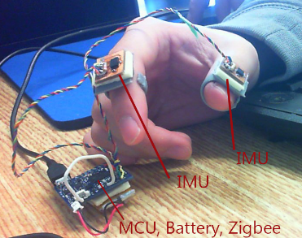
Motivation/Intro
Our Solution
A wearable device, two rings with motion sensors / IMU to track fingers’ movements and gestures.
It is acceptable (fashion), affordable, functional, enable rich interactions…

Slide 4
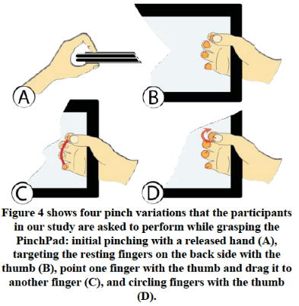
Related Work
PinchPad
How accurately can the user simultaneously position the fingers and thumb?
Is the subjective self-assessment correlated with objective measurements of accuracy in terms of pointing and trajectory paths such as length and direction?
And what gesture performance parameters are the most stable ones and therefore suitable to serve as features for classification?

Slide 5
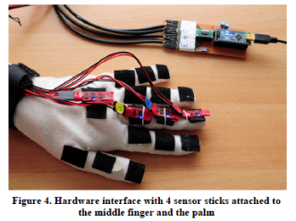
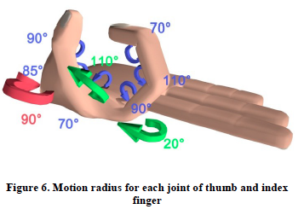
Related Work
Whole Hand Modeling
to interpret highly complex hand gestures, our aim is to detect the whole hand with any finger configurations while the possibility of holding devices shall be given.

Slide 6
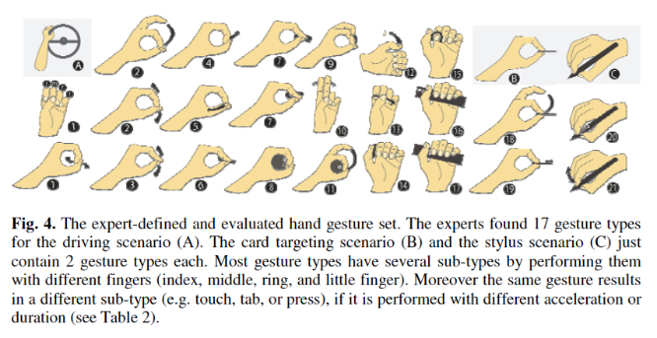
Related Work
A Taxonomy of Microinteractions
This paper explores and identifies microgestures and finger movements that are performable and does not draw significant attention away from the primary manual task which is to be done in parallel.

Slide 7
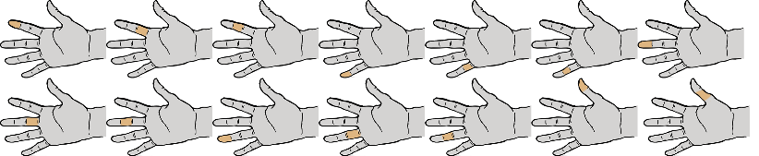
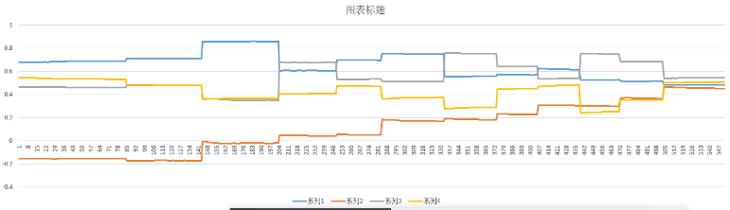
Approach
Tap / Hover
Quaternion / State mapping (kNN, works even k == 1)

Slide 8
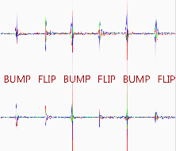
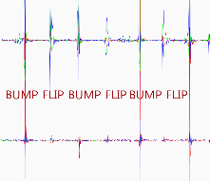
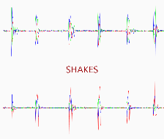
Approach
Bump / Flip
Acceleration / Linear SVM (tapping motion on side of the device, Yang Li, etc). Combine the information from Tap/Hover detection.
Tap on fingers
Tap on desk
Hand Shakes

Slide 9
Approach
Swipe
Reverse quaternion interpolation
Hand posture estimation
Use LeapMotion data as training samples.
Being aware of the context (“palm, pad, side”), potentially still-movable hand parts are known as well.
Users are to be involved to evaluate the algorithms

Slide 10
Demo Applications
Grasping gestures to enhance interacting with grasped objects
Mobile phone, e,g, input with index fingers for one-handed interaction
Mouse
Tablet pen

Slide 11
Demo Applications
Grasping gestures to perform a second task
Answering phone calls while driving, holding a cup

Slide 12
Studies
Users’ subjective feedback
…

Slide 13
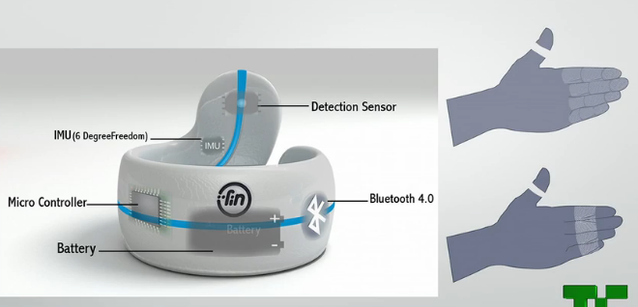
Existing Products
http://www.finrobotics.com/ (swipe and tap)
http://techcrunch.com/2014/01/08/the-fin-is-a-bluetooth-ring-that-turns-your-hand-into-the-interface/
http://www.messagetoeagle.com/googleglasses.php

Slide 14
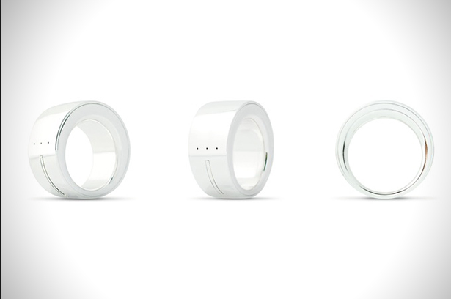
Existing Products
The “Ring” project
https://www.reddit.com/r/videos/comments/2ntr7e/worst_product_ever_made_ring_by_logbar/
Why people think it is the worst product?
It is too big.
Hardware only works half the time.
Gestures work about 5% of the time.
Bad user experiences.
Expensive.

